Slide 1

Brother Carl Wamble
Notes:
GOOD MORNING
THANK YOU FOR THIS OPPORTUNITY TO COME HERE TO SPEND SOME TIME WITH THE SAINTS THAT MEET AT THIS LOCATION

Slide 2

Notes:
I BELIEVE YOU ARE HERE BECAUSE YOU LOVE THE LORD AND YOU REALIZE THAT YOU ARE THE HANDS AND FEET AND HEART OF THE BODY OF CHRIST.

Slide 3
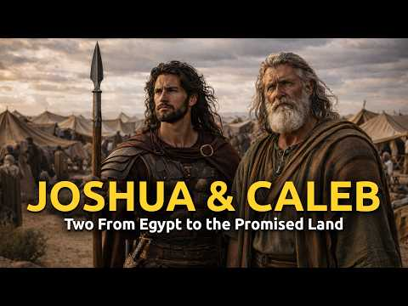
Notes:
I am not a spy
This is the first leg of a fact finding mission
WHAT DID JOSHUA AND CALEB DO????? GATHERED INFORMATION
I AM HERE TO ASK QUESTIONS…………….HOLD UP A MIRROR……………ASSIST YOU IN SEEING THE WONDERFUL THINGS GOD HAS PLANNED FOR MONTCLAIR

Slide 4
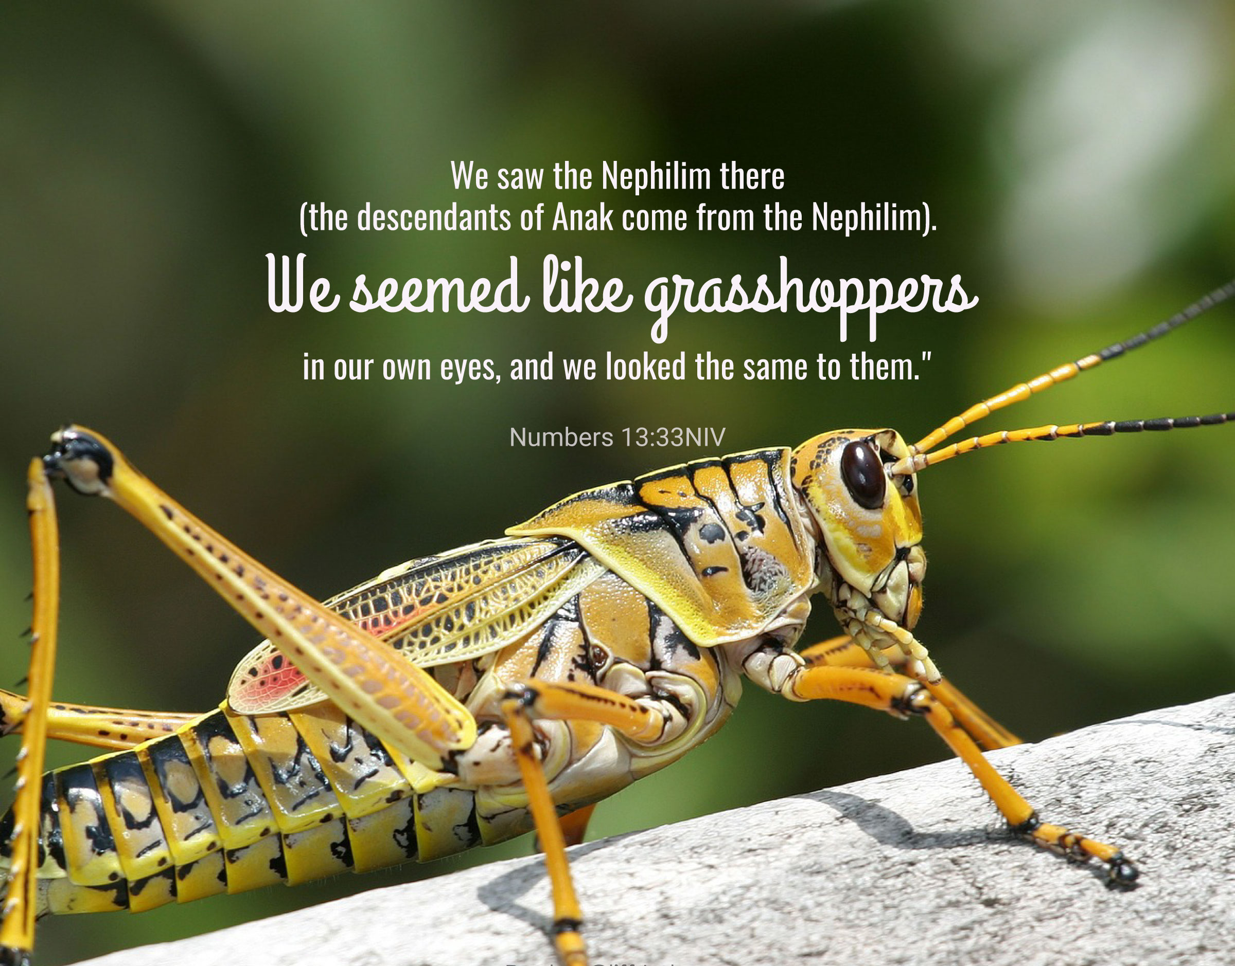
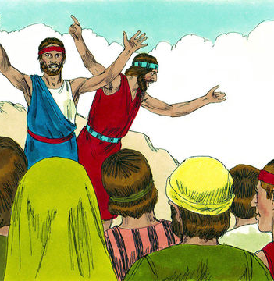
Do not rebel against GOD
Notes:
REMEMBER WHEN THE MEN OF GOD WENT INTO THE PROMISE LAND FOR 40 DAYS NOT ALL OF THEM CAME BACK WITH A POSITIVE REPORT
YOU SEE SOMETIMES WHEN PEOPLE FACE CHALLENGES …….THEY SEE ALL OF THE THINGS THAT COULD GO WRONG
THE OTHER TEN MEN SAID
WE CANNOT GO UP AGAINST THESE PEOPLE ……THEY ARE GIANTS
AND THEY SPREAD AMONG THE ISRAELITES A BOAD REPORT
NOW REMEMBER GOD HAD ALREADY PROMISE THEM THAT THEY WOULD BE ABLE TO TAKE OVER THE LAND

Slide 5
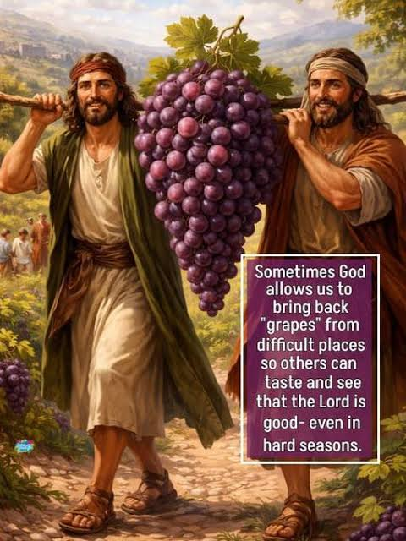
JOSHUA AND CALEB
NUMBERS 13
Notes:
JOSHUA AND CALEB CAME BAC WITH THE POSITIVE REPORT

Slide 6
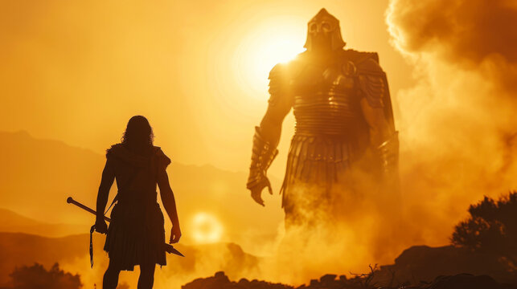
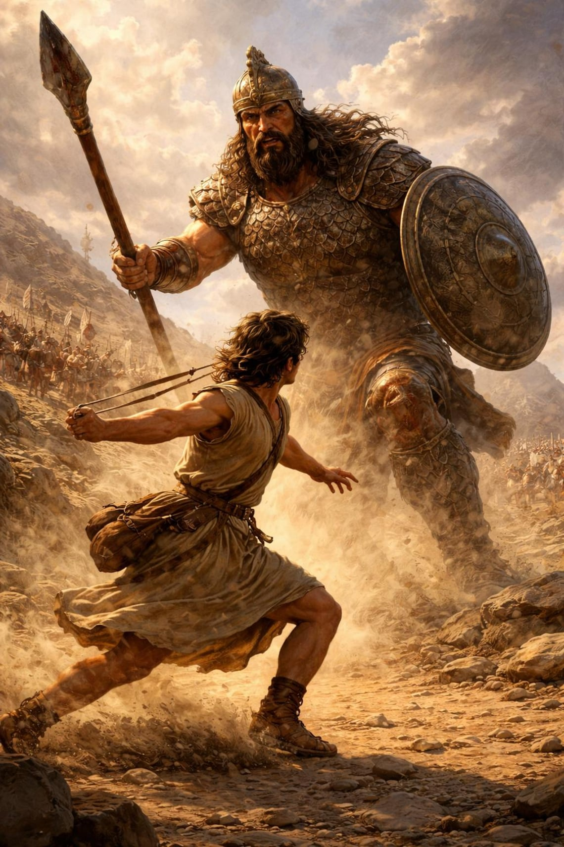
Notes:
YOU ALSO REMEMBER DAVID AND THE GIANT GOLIATH WHO THREATENED THE PEOPLE OF GOD
WHEN DAVID WENT TO GO SEE HIS BROTHERS THEY WERE TERRIFIED OF GOLIATH
WHEN GOD GIVES US A TASK……………HE PROVIDES US WITH EVERYTHING WE NEED
YOU ARE HERE AT THIS PLACE……..BECAUSE GOD KNOWS THAT YOU CAN MAKE A POSITIVE CONTRIBUTION TO WORK IN THE MASTER’S VINEYARD

Slide 7
S T P
Striving Toward Perfection
Notes:
WITH MANY SITUATIONS IN LIFE WE HAVE OPTIONS
YOU HAD OPTIONS TODAY……………………THANK YOU FOR COMING HERE

Slide 8
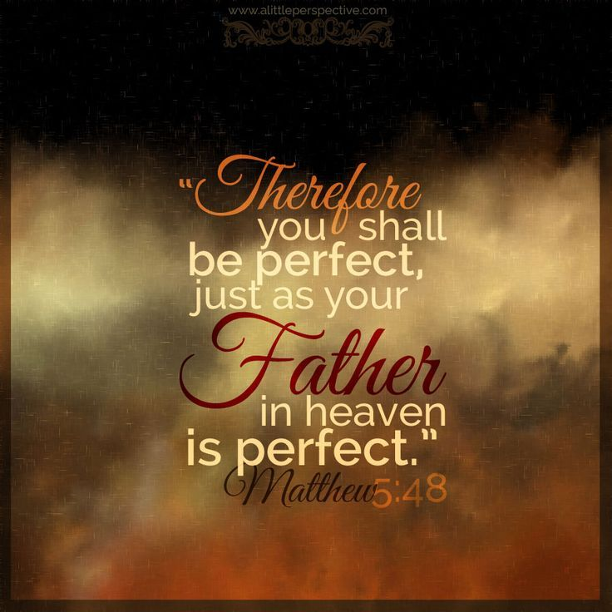

Slide 9





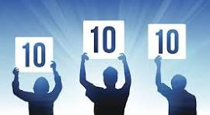

Slide 10

APPRECIATIVE INQUIRY
APPRECIATIVE INQUIRY IS THE DISCERNMENT OF WHERE GOD IS
ALREADY AT WORK IN YOUR CONGREGATION
AND HOW YOU MIGHT JOIN IN THAT WORK
APPRECIATE- To value, admire, recognize with gratitude
INQUIRY- Investigate, search into, explore what works well
Notes:
IF OUR FOCUS IS POSITIVE LIKE DAVID AND JOSHUA AND CALEB OUR ENERGY AND PERHAPS THE ENERGY OF EVERYONE AROUND US WILL BE INFLUENCED
THINK OF SOME OF THE BIBLE CHARACTERS WHO CHOSE TO GO POSITIVE INSTEAD OF NEGATIVE IN ADDITION TO DAVID AND JOSHUA AND CALEB
ABRAHAM…………….HERE AM I SEND ME……DID HE ALWAYS HAVE THE MOST OPTIMISTIC OUTLOOK……..NO………………WHAT ABOUT WHEN HE SAID HIS WIFE WAS HIS SISTER
WHAT ABOUT PETER…………………………LORD I WILL FOLLOW YOU ANYWHERE………………..JESUS SAID BEFORE THE ROOSTER CROWS YOU WILL DENY ME
PETER WAS ALSO OPTIMISTIC ABOUT JUMPING OUT OF THAT BOAT………………..AND THEN HE WAVERED……………………….HIS FOCUS CHANGED AND HE STARTED TO SINK

Slide 11

APPRECIATIVE INQUIRY
TRADITIONAL
APPRECIATIVE INQUIRY
FELT NEED (IDENTIFICATION OF PROBLEM
ANALYSIS OF CAUSES
BLAME AND SHAME
SHUT DOWN OF CREATIVE THINKING AND WORKING OUT OF DEFICIT THINKING
DERIVE POSSIBLE SOLUTIONS
TREATMENT OF AN ILLNESS
APPRECIATING/VALUING THE BEST OF WHAT IS
ENVISIONING”WHAT MIGHT BE” PREFERRED FUTURE STATE
INVITATION TO JOIN IN CREATIVE THINKIING AND DIALOGUENA
INNOVATIVE PROTOTYPING OF WHAT WILL BE RESOURCES
DESTINY OR GOAL ATTAINMENT

Slide 12
APPRECIATIVE INQUIRY PRINCIPLES
CONSTRUCTIONIST PRINCIPLE
POSITIVE PRINCIPLES
SIMULTANAIETY PRINCIPLE
POETIC PRINCIPLE
ANTICIPATORY PRINCIPLE
Notes:
ANTICIPATORY PRINCIPLE …..BELIEVE THE FUTURE WILL BE POSITIVE AND IT WILL

Slide 13
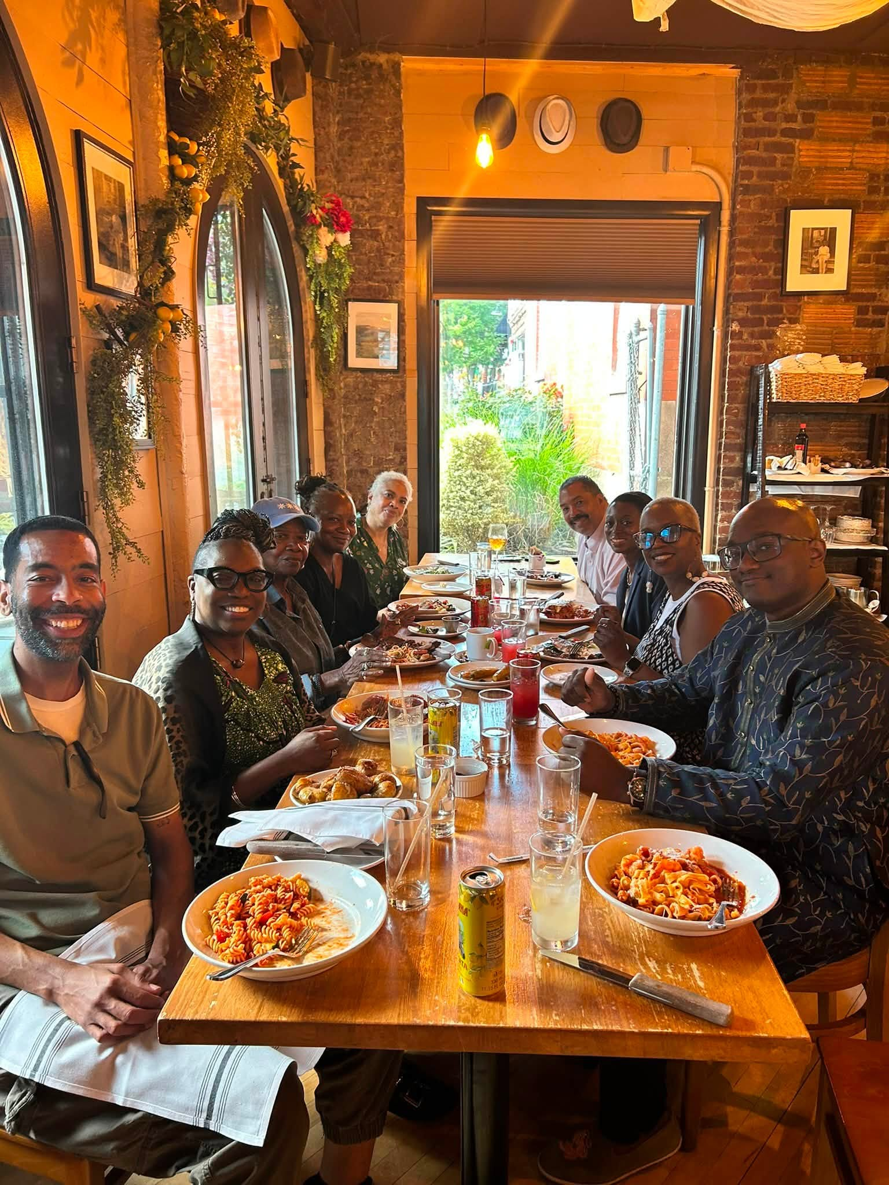
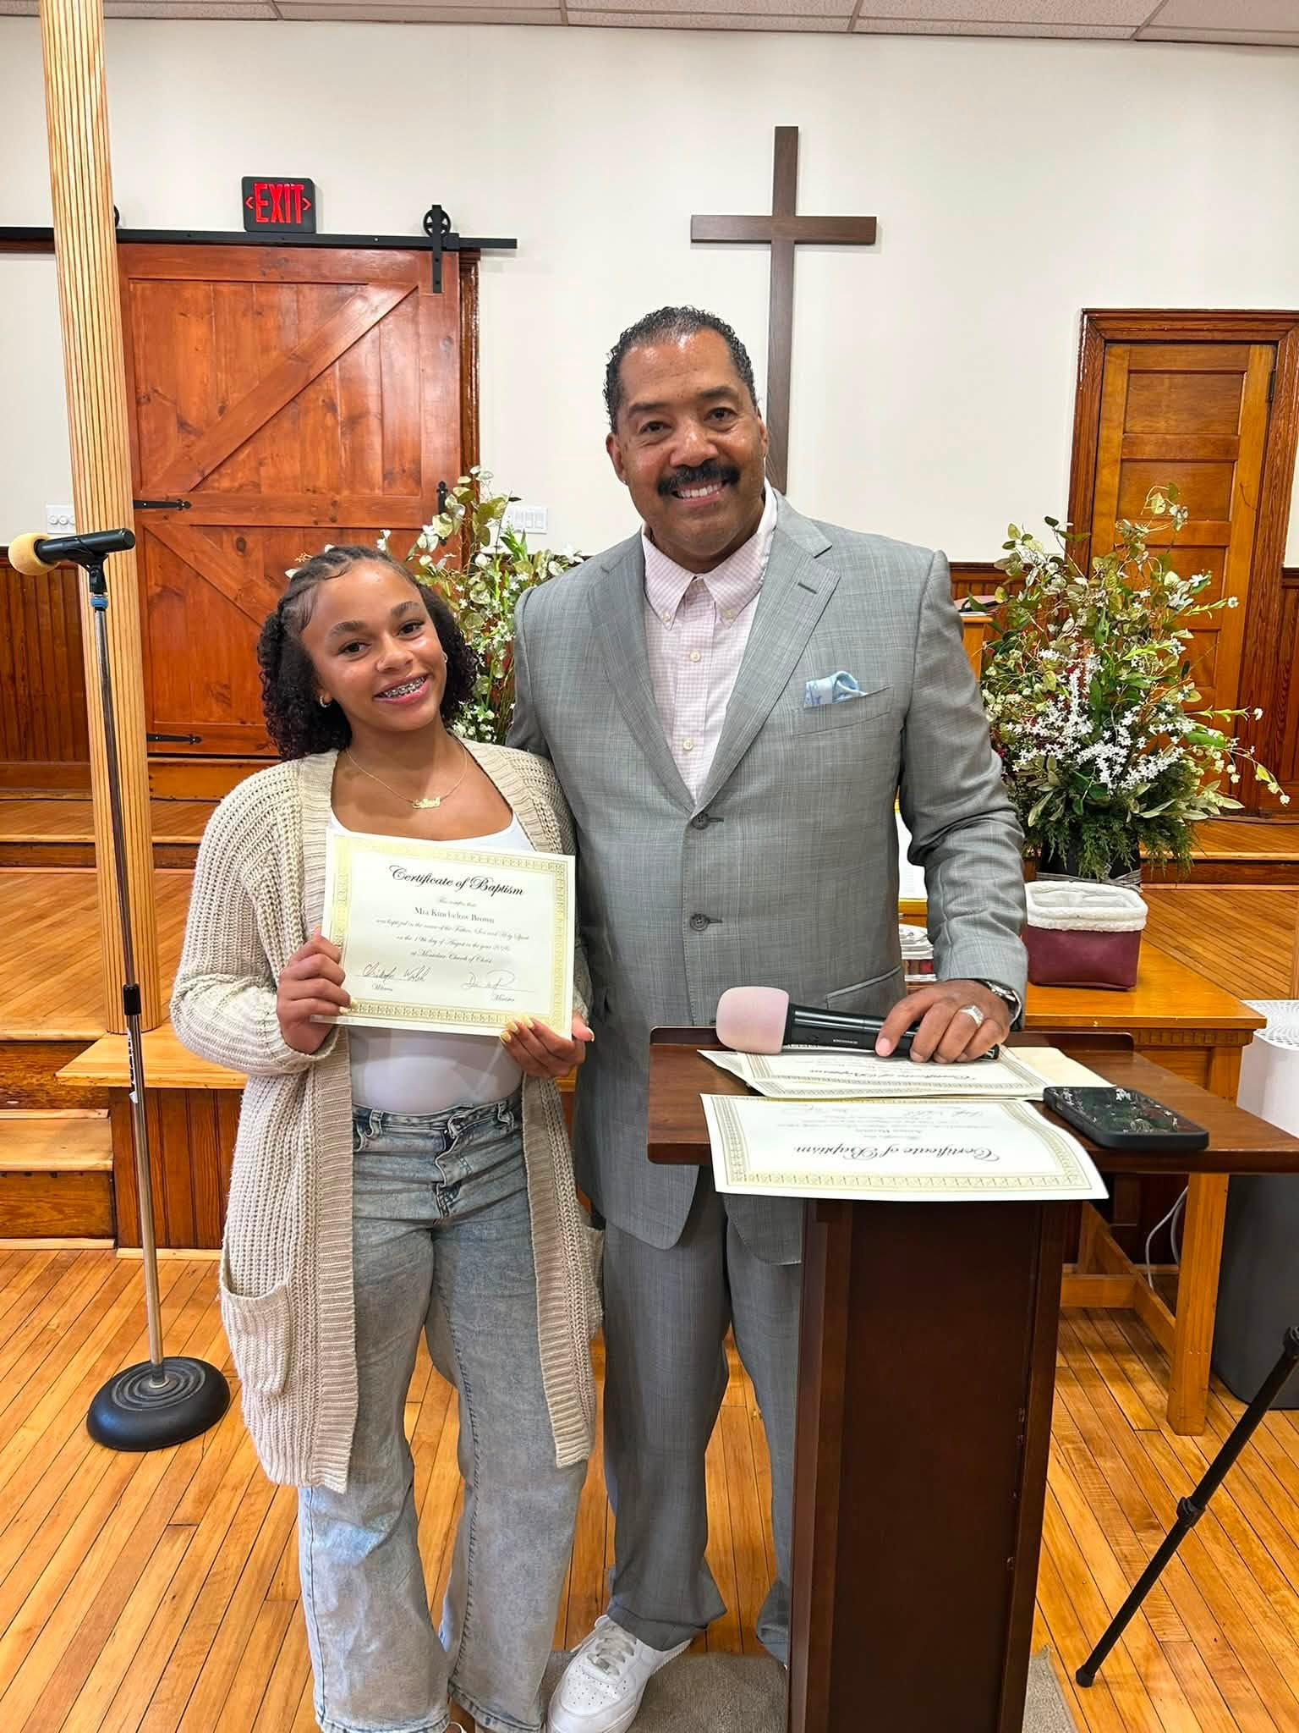
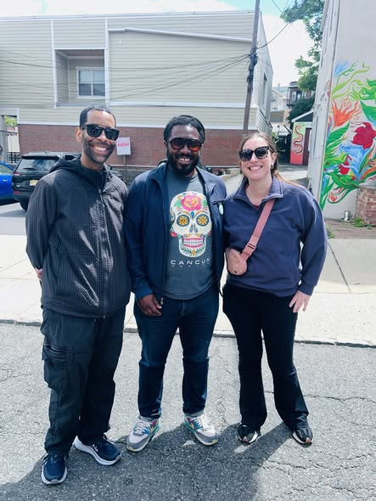
MONTCLAIRE
CHURCH OF CHRIST
“WE MAY BE SMALL IN NUMBER BUT WE’RE MIGHTY IN MINISTRY.”
8 RECENT BAPTISMS
CONSTRUCTIONIST’
POSITIVIST, AND
SIMULTANEITY
PRINCIPLES
PERSONIFIED
Notes:
THE WAY WE TALK INFLUENCES WHAT WE DO
THE WAY WE COMMUNICATE REFLECTS OUR SPIRITUAL HEARTS. THE ABOVE QUOTE IS DIRECTLY FROM THE MONTCLAIR WEBSIGHT
JOY AND PLAYFULNESS LEAD TO CREATIVITY AND EXPLORATION ON NEW ADVENTURES AND ACTIVITIES.
DISCOVERY AND LEARNING CONTRIBUTE TO THE INCREASED SELF AWARENESS AND POSITIVE PREFERRED FUTURING

Slide 14
Our Mission
The mission of the Montclair Church of Christ is to preach the Gospel of Christ so that others might be saved, and to enhance in believers their love of God in order that their lives may be continuously transformed by and toward Christ Jesus.

Slide 15
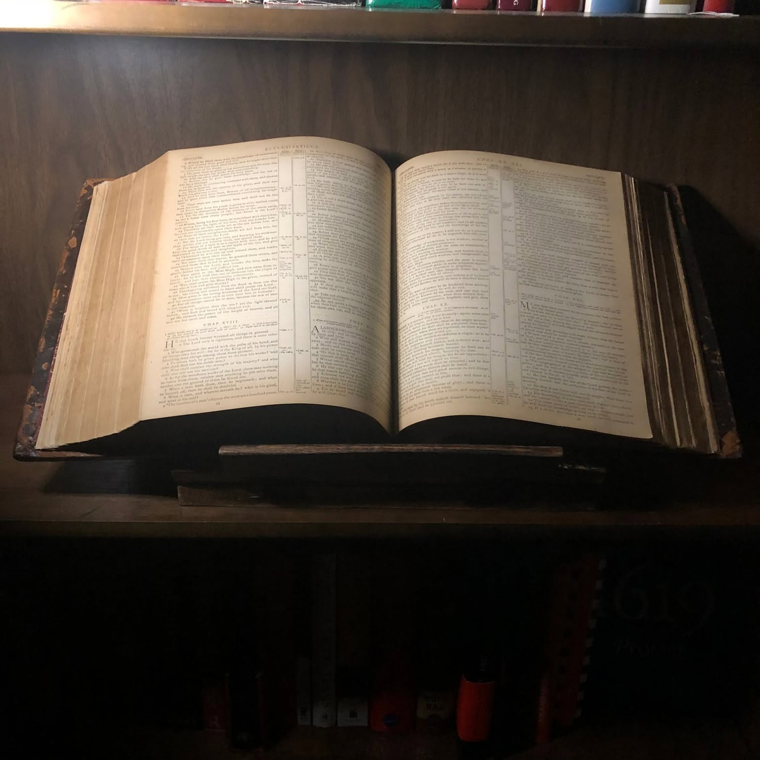

Montclair
Church of Christ
VALUES
Following the simple teachings of Christ as found in Scripture, seeking unity in faith as the early church did.
Saving Souls and Keeping Souls Saved
Committed to evangelism and spiritual growth, helping believers remain strong in their faith journey.
Extending a Loving Welcome
Creating a warm, inclusive community where all are welcomed as family.
Pre-denominational Christianity

Slide 16
Montclair Family Question Responses
God has uniquely gifted each of us — and when those gifts are recognized, embraced, and put to work together, the Kingdom grows. This workshop is an opportunity for the Montclair Church of Christ family to come together, discover how your personality gifts can serve a greater purpose, and begin building the structure and vision that will carry our congregation forward.

Slide 17
SUGGESTED GROUND RULES
NO PERSONAL ATTACKS
NO EQUINE FLOGGING
ELMO
PARTICIPAGTE
ANY QUESTION OR INQUIRY IS LEGITIMATE
STAY OPEN TO NEW IDEAS
BE LIKE JESUS
PARKING LOT
ENJOY THE FELLOWSHIP

Slide 18
EXPECTATIONS
WHAT DO YOU ANTICIPATE WE WILL OBTAIN BY SPENDING THIS TIME TOGETHER?
WHAT WOULD YOU LIKE TO HAPPEN TODAY?

Slide 19
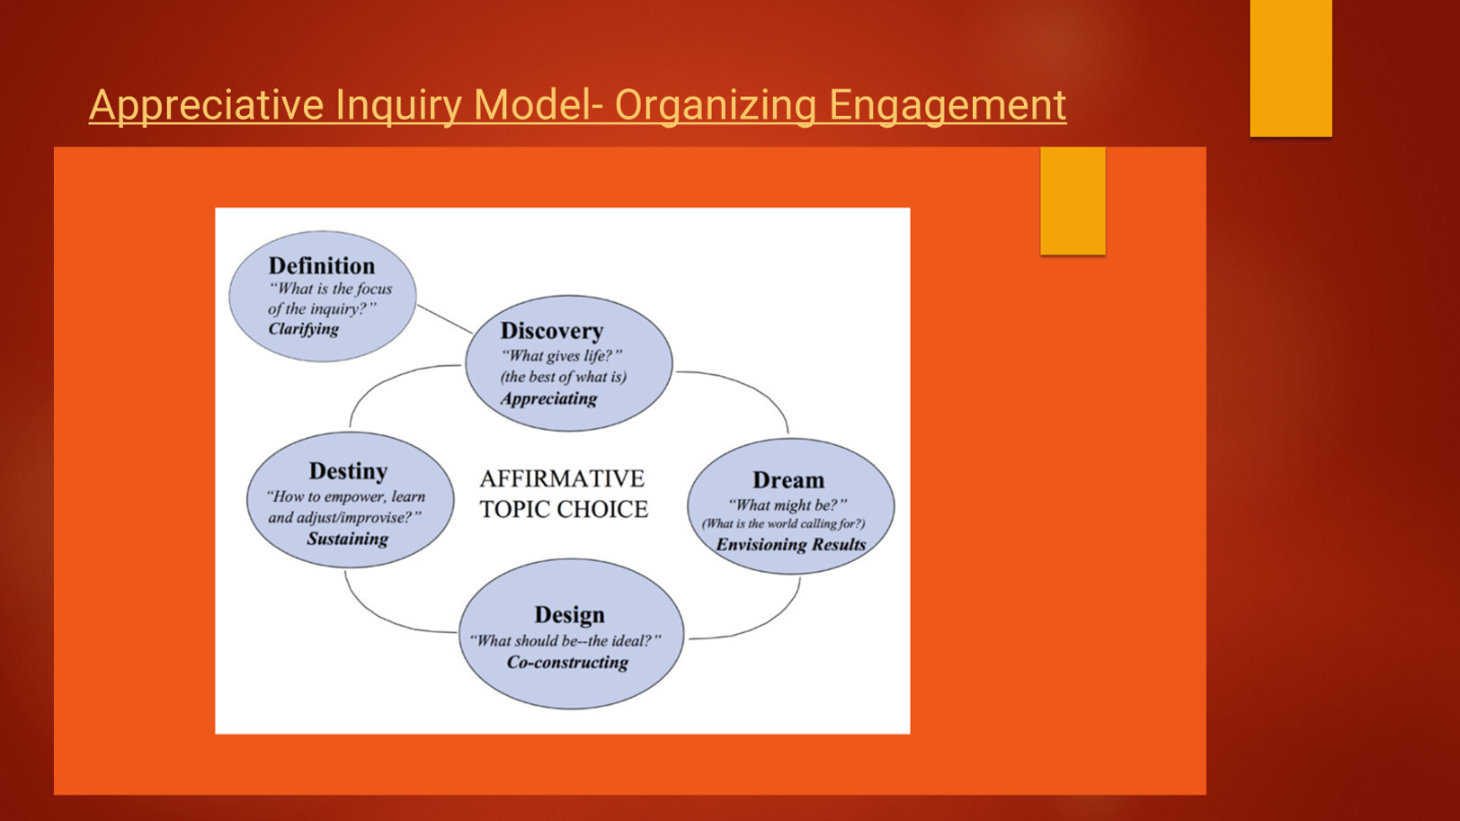
Notes:
FOCUS---WHEN WE FOCUS ON WHAT WE HAVE DONE WELL OR WHAT OUR ORGANIZATION HAS DONE WELL……WE CHANGE THE ENERGY
IF WE FOCUS ON THE NEGATIVE …….IT INFLUENCES OUR ENERGY
ANY CHANGE IN AN ORGANIZATON STARTS WITH OURSELF

Slide 20
STRENGTHS
As a whole ,we are strong in welcoming people both members of the Church of Christ we know from other congregations
Congregation loves well
Preach true gospel
Attempt to create a relationship with each member as a primary goal
Strengthen each members relationship with Christ
Able to create a culture being small enough
Very educated body of members with post graduate degrees allowing us to decipher in depth Bible Study
Creativity; having a current environment where ideas are welcomed and celebrated individuals can perform their ideas and get support from members in trying.
Talents; individuals have unique professional talents that can be leveraged by the congregation.
Location: we are in downtown Montclair in close proximity to posh restaurants and stores. Our surroundings present a community of aflluent wealth and prosperity.
Friendships: our small congregational size allows for members and visitors to organically developer friendships that go beyond the usual services of Sundays and Wednesday evenings.
Paid-off building; our building is paid off taking away the concern of a mortgage.

Slide 21
WEAKNESSES
Absences; understandably some members travel and will not be available in services. This requires the limited number of brothers available to have to take up the slack.
low offerings: we have members who intentionally don't give on a regular basis on Sundays, if at all. This puts strain on the operations of the church and it is widely known members can give more because we are aware of their livelihoods and lifestyles.
Gender-imbalance; there are more sisters than brothers at the moment and this maintains a culture where sisters have more sway on what is considered acceptable and unacceptable of topics that are brought up in bible studies and sermons.

Slide 22
OPPORTUNITIES
Outreach; several of us make it a regular habit to frequent the local stores and nurture relationships with store owners making it known our prescence and knowing the owners by a first-name basis.
Unhappy or searching for a congregation to call home
large number of families that have school aged children of all grades. THere is a way to connect to them but
we lack the resources of a modern church for that.
N ee to start leveraging social
Technological Outreach: we recently updated our website and have a tech profressional among the membership able to manage the website, mobile app, and any other things of a high technological knowledge. Other members are taking up responsibilities to assist in social media outreach through the technology that is being developer for further outreach. Our zoom allows for members and visitors to stay connected with our community. Further expansion in this area can lead to greater involvement.
need to start leveraging social social

Slide 23
THREATS
Passive aggressiveness; there are a few instances where members who have a beef with other members are expressing them through public displays of defiance. One such example is the use of general prayer as a weapon of criticism indirectly towards another member.
monetary security; because of the low reception of offering gathered with only a few members producing the most, paying for common bills to keep the building operational becomes a burden to leadership sometimes having to go through drastic measures to find a way to keep the facilities available.
Procrastination; there are times when members involved in ministries and other activities are waiting on other members for vital information that holds back progress being made. Even after multiple follow-ups, actions are delayed due to lack of focus and outside distracts.

Slide 24
1. Rejuvenated about serving God
Felt like:
I could see that my service was genuinely helping somebody grow, heal, feel supported and draw closer to God. Purposeful
Spiritually Energized
Grateful
Reminded that God can use our experiences, gifts and even our challenges for something greater than ourselves
Inspiratiion, Relief, Hope
I felt like a new person
Excited
Like nothing can bring me down
Like I was wanted and needed in the community of believers
I felt like my talents were being recognized, appreciated
I felt rejuvenated

Slide 25
Most alive in Serving God While at Montclair
Song Leading, Welcoming visitors
When scriptures were read and how it related to what I was going through personally
When we are successful with events, Mentoring young people
When we really “get” as a team
When I have prepared flyers for various events
Genuine fellowship, meaningful conversation
Opportunity to serve beyond the walls of the building
Moments when brothers and sisters are genuinely encouraging one another
Strengthening families’ Demonstrating Christ through action
The church is a fellowship of people actively living out Christ through action

Slide 26
WILLING TO DO
Cooperate with goals and mission as well as activities that help with outreach and education
Connect with people
Develop relationships
Organize ideas and help turn vision into action
Use my experience in: education, leadership, OD, working with young people.
Active listening, Encouraging, Teach, Build partnerships,
Develop programs that can help people grow
Strengthen men’s mionistry, family development,
Community outreach
Strategic planning for the congregation

Slide 27
WILLING TO DO
Translate Spanish to English and English to Spanish
Sing
Be present when called
Participate and give
Think of ideas and ways to be part of the community
Promote fellowship with each other with things that we can do together

Slide 28
5 YEAR VISION
Continous fellowship with others both within and outside the fellowship
A robust beacon in the Montclair community with consistent growth spiritually and numerically’
Like Joseph…………..everything he touched flourished
Montclair recognized as a spiritually strong, loving multigenerational congregation where people attend and actively grow
Growing as disciples and serving others
Thriving ministries for children, youth, young adults, families, men womeStnb and seniors
Meaningful community partnerships and intentional presence of Montclair and the surrounding community
A congregation known as a welcoming people wherever they are in life developing their God given gifts
Strengthening families, addressing real community needs
Preparing the next generation of Christian leaders
People will look to Montclair Church of Christ and see a congregation
where love of Christ is visible in how we live teach AND SERVE

Slide 33
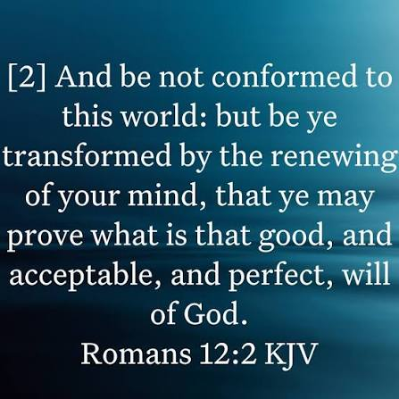

Slide 34
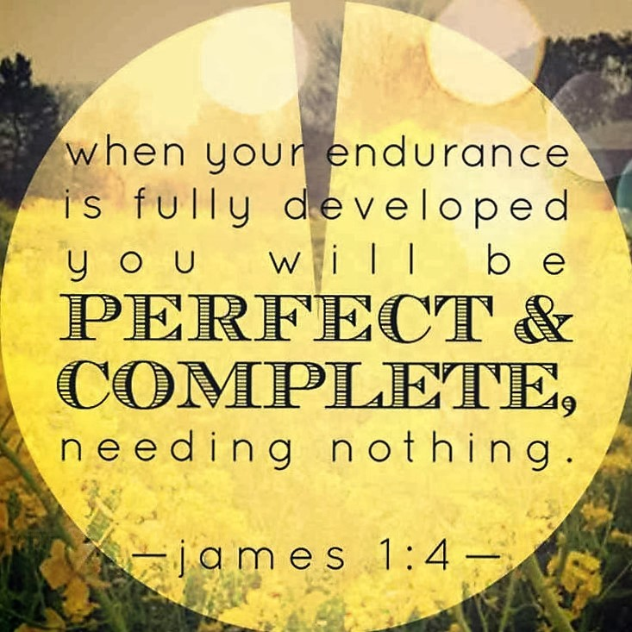

Slide 35
REFLECTIONS

